Slide 1


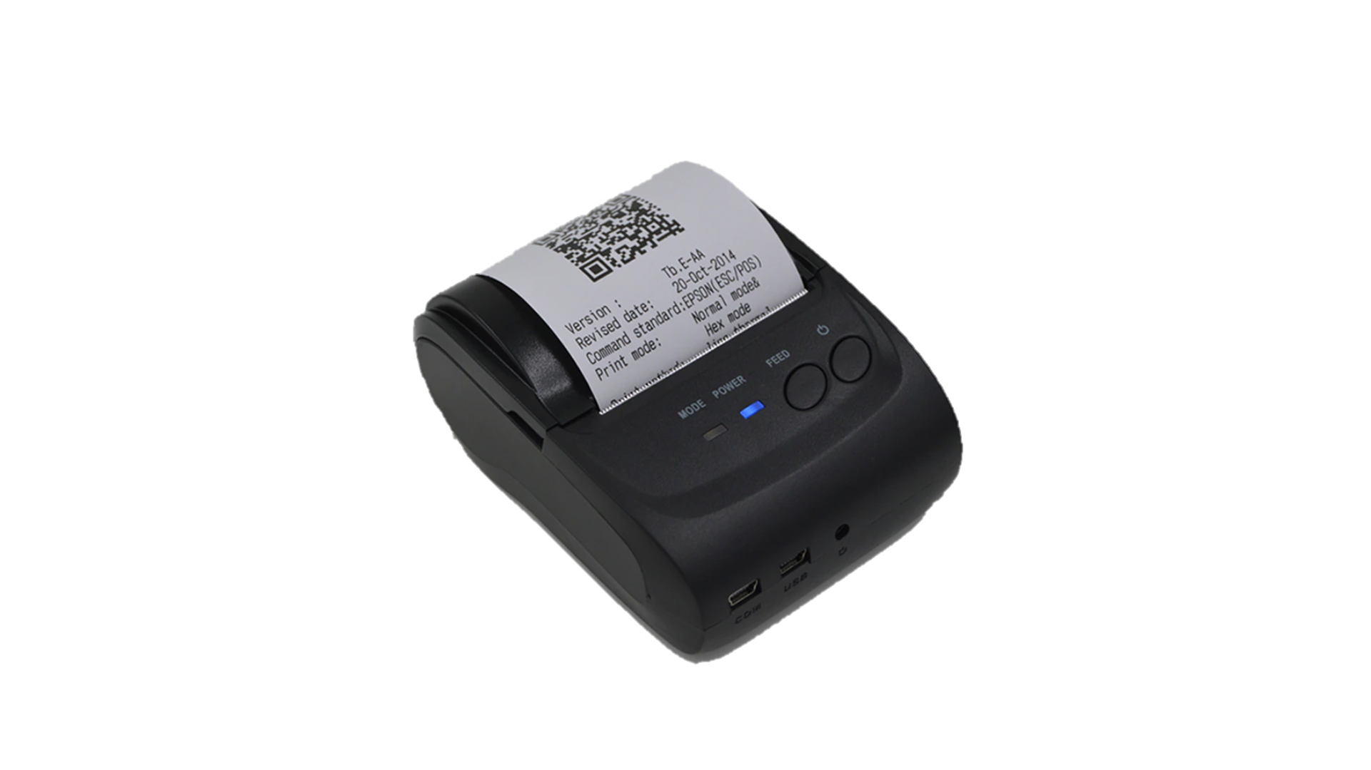
HOW TO CONVERT STOCK TO SWMS
1/2
Convert stock meaning: Trial run new SWMS concept for current stock & Apply parallel 2 system for new delivery
GOOD RECEIPT
STORING
KITTING
Issue unique QR code
E-map
store
Just transfer
OCR
Type 1
(for unique QR):
- Verify by unique box
- Issue qty from each box
no QR code
5% ~ 500 items
Paste to 100% box
2
New type
Receiving card
Key in position
Scan 100% box
Up to date
Have QR code
(unique)
84% ~ 7,860 items
paste
Smart WH
system
SWMS CONCEPT
Scan QR
(unique)
1
Type 2
(for non unique QR):
- Verify by
Receiving card
- Issue qty from 1 lot
Have QR code
(Non unique)
11% ~ 1100 items
direct
print
Kitting
plan
Scan QR
(non unique)
E-map
Suggest position
There 2 points of current stock need to change to new concept
1
2
1
Add new Receiving card for all lot
2
Key in position to E-map
Current
Receiving card
Use together
E-map
store
up to date
Print new RC
None QR code
Have QR code
Key in
Convert stock scheme
Trial run GR & Store
Trial run kitting & Supply
GO-live
New delivery
Moving part
Convert stock
Non/slow moving
Moving part
Balance stock
GR & store
Run parallel 2 systems
Run parallel 2 systems
Run new system
Kitting
Run current system
New system [main run] - Current system [backup]
Run new system

Slide 2
Trial run & GO-live history
2/2
1. Trial run strategy: Trial run GR & store ➔ Convert stock ➔ Trial run kitting & supply
Trial run
order
Trial run 1 plant
Trial run 2 plants
Trial run 3 plants
GO-LIVE all plants
Fix error
Fix error
Fix error
Trial run Good receipt & Storing (in 3W)
Convert stock (in 2W)
Balance stock
Trial run Kitting (in 2W)
New system
SWMS
New system [Main run]
- Running 100% kitting by new system (Direct SAP)
- Kitting leadtime change: N-1 ➔ N-2 (early 1d for safety)
- Mins stock parallel vs current system
- Check inventory daily
GR & Store: Running parallel 2 systems
Compare
Crrent
system
Current system
Current system [Backup]
Kitting: Running current system
- Issue partcard 100%: compare quantity vs new system & backup
2. Trial run & Go-live schedule
Convert stock schedule
Trial run schedule
Go-live schedule
No | BU/BD | Item qty | Kitting time daily | Ag |  |  |  | Sep |  |  |  | Oct
 |  |  |  | W1 | W2 | W3 | W4 | W1 | W2 | W3 | W4 | W1 | W2 | W3 | W4
1 | PAP-RF | 238 | 180
2 | MEBD | 1,638 | 1,250
3 | KABD | 1,477 | 1,500
4 | SCBU | 2,606 | 2,700
5 | ISBD | 877 | 220
6 | DIP | 930 | 800
7 | VSBU | 845 | 500

Slide 3





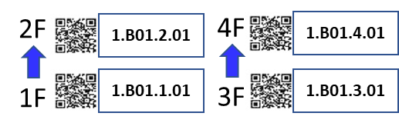
RLE for paste QR code to rack
Naming rle
1. Pallet QR name position
1.B01A.4.01
01 : nit location
4 : Floor of rack
01A : Q’ty rack
B : Big rack
S : Small rack
P : Pallet
1 : PSNV first floor
2. Big rack QR name position
3. Small rack QR name position
4F
3F
5th
5th Floor
4th Floor
4th
2F
3rd Floor
3rd
2nd Floor
2nd
1F
1st Floor
1st

